Slide 1

HORSE TRAP
A simulated insider privilege escalation
Giann Berrospi and Michael Doronio

Slide 2

What is it?
An insider attack simulation targeting vulnerable user data inside an unauthorized workstation
Demonstration of a trojan horse and persistence
Exploration of data analysis and lessons learned

Slide 3

Why it matters...
60% of data breaches are caused by an inside threat
Harder to detect as a threat
Easier to attack network if you already have access to sensitive data
In 2020 , GE was the victim of an insider attack by two of their employees

Slide 4

Setting the Stage
Disgruntled HR employee
Wants to steal information /assets
Plans to start their own company
Target the head of the finance department to get what they need
QnJvdWdodCB0byB5b3UgYnkgQSBTZWNyZXQgT3JnYW5pemF0aW9uCg==

Slide 5
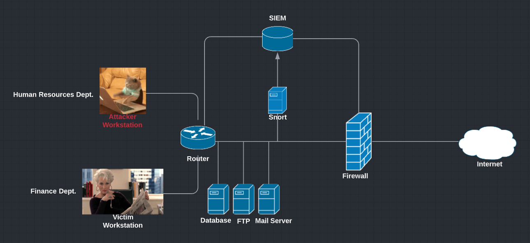
The Network

Slide 6
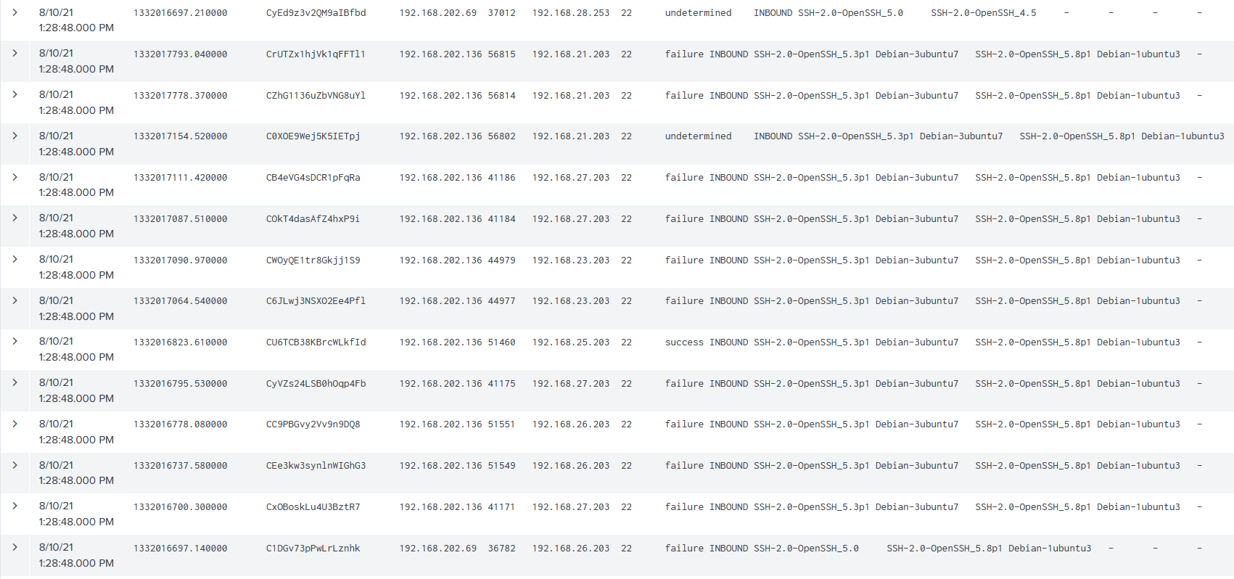
Shortcomings

Slide 7
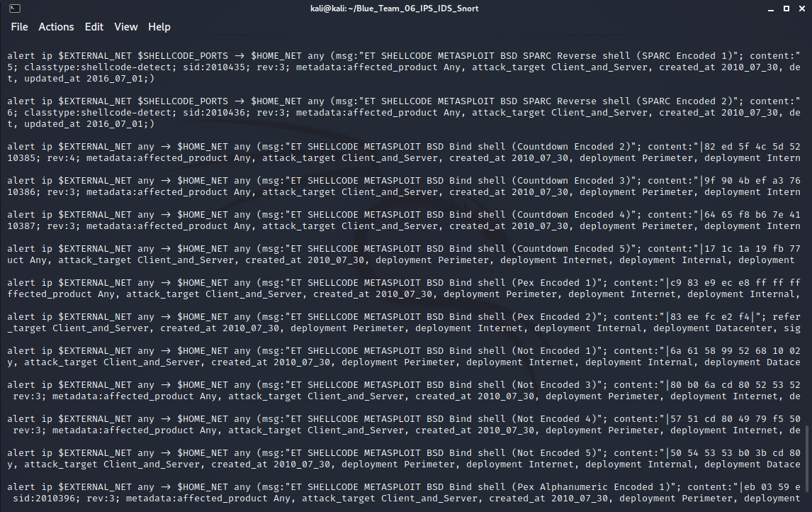

Slide 8
Conclusion
What is your organization’s strategy for insider threats?
Are there gaps in your network that an insider can take advantage of?
A strong security posture is dynamic; new threats emerge everyday that can directly compromise your business from the inside

Slide 9
Resources
5 real-life examples of breaches caused by insider threats. 5 Real-Life Examples of Insider Threat-Caused Breaches | Ekran System. (2020, December 15). https://www.ekransystem.com/en/blog/real-life-examples-insider-threat-caused-breaches.
academy, A. A. (2020, December 2). Incident response case: From ssh tunnel to endpoint analysis. Medium. https://alparslanakyildiz.medium.com/incident-response-case-from-ssh-tunnel-to-endpoint-analysis-a4a7c9d0b67d
Peter Draper Technical director at Gurucul. (2020, January 7). How social engineering is changing the insider Threat Game. Infosecurity Magazine. https://www.infosecurity-magazine.com/opinions/social-engineering-insider-threat/
Phishing: Spearphishing Attachment. Phishing: Spearphishing Attachment, Sub-technique T1566.001 - Enterprise | MITRE ATT&CK®. (n.d.). https://attack.mitre.org/techniques/T1566/001/
You can view our project at: https://github.com/Luzonica/projects

